Slide 1
GO TEAM MEETING #1
Toomer ES

Slide 2
TOPICS
School Uniform Discussion
Principal’s Report
Current Enrollment & Leveling
Information about our school

Slide 3
DISCUSSION: OPTIONAL SCHOOL UNIFORM

Slide 4
OPTIONAL SCHOOL UNIFORM
In the 2023-2024 school year, the APS Board of Education updated the district’s dress code policy. As part of the update, starting with the 2025-2026 school year if a school wishes to maintain or explore implementing an optional school uniform, it must go through an engagement process and have a vote as outlined below:
ELEMENTARY
MIDDLE
HIGH
A school uniform is adopted upon the agreement of the principal and a majority vote of the School Governance Team (GO Team).
School uniforms are adopted upon the agreement of the principal, GO Team and the elected student government. If the school does not have an elected student government, then a majority vote must be secured from the student body to adopt a school uniform.
School uniforms are adopted upon the agreement of the principal, GO Team and the elected student government. If the school does not have an elected student government, then a majority vote must be secured from the student body to adopt a school uniform.
If your school currently has a school uniform and wishes to continue it, you must go through this process!

Slide 5
ABOE POLICY JCDB STUDENT DRESS CODE (Last Revised, 06/03/2024)
http://tinyAPS.com/?APSDressCodePolicy
REQUIREMENTS
RESTRICTIONS
A top of non-see through fabric
A bottom of non-see through fabric
Shoes
Undergarments that are not visible
No words or symbols that are gang-related, sexually suggestive, obscene or promote illegal behavior
Nothing associated with alcohol, illegal drugs or tobacco
No flip-flops, athletic slides or footwear that doesn’t support the front and back of the foot

Slide 6
SCHOOL-SPECIFIC DRESS CODES
We have one districtwide student dress code adopted
by the Atlanta Board of Education.
School-specific dress codes may not contradict Board policy.
Examples of problematic school specific dress-code provisions
“dress in good taste”
“no baggy pants”
“no sweatpants”
“no activewear”
“no short shorts or skirts”
“no spaghetti straps”
“no tube tops”
“no dresses”
“no tight/revealing clothing”
“no leggings”
“no joggers”
“no ‘extreme’ hairstyles or colors”
“no Crocs”
“all shirts must be tucked in
“no hoodies/hooded jackets”
“hair should be clean and neatly groomed”
“no shirts which expose cleavage”
“students dressed in uniform are better perceived by teachers and peers”

Slide 7
SCHOOL UNIFORMS
Schools may choose to adopt an optional school uniform.
Effective immediately, at no time will students have their instructional time interrupted or be barred from school or class for declining to wear the optional school uniform.

Slide 8
ESTABLISH AN OPTIONAL SCHOOL UNIFORM
If your school currently has a school uniform and wishes to continue it, you must go through this process!
The GO Team needs to TAKE ACTION (vote) on maintaining or exploring implementing an optional school uniform.
After the motion and a second, the GO Team may have additional discussion. Once discussion is concluded, the GO Team will vote.
If the GO Team votes to move forward, then the team should proceed to discuss the School Uniform Advisory Committee.
TAKE ACTION

Slide 9
DISCUSSION
Only needed if the GO Team voted YES to maintaining or exploring establishing an optional school uniform.
The GO Team will now discuss if they wish to move forward with establishing a School Uniform Advisory Committee.
The School Uniform Advisory Committee will be responsible for:
Develop a stakeholder engagement plan to receive feedback on implementing a uniform and its components, if adopted. Must include a minimum 20-day public comment period on any proposed uniform
Recommending the optional school uniform components.
Establishing the student voting timeline and process (if necessary).
Determine the length of time the uniform will be in use before reconsideration
Developing a communication plan to inform the school community about the optional school uniform, if the uniform is adopted
Other objectives as defined by the GO Team.

Slide 10
COMMITTEE MEMBERS
Only needed if the GO Team voted YES to maintaining or exploring establishing an optional school uniform.
The GO Team will also need to determine who will be on the committee:
The GO Team Chair will name the Committee Chair.
No more than 2 additional GO Team members may be on the committee (a maximum of 3 GO Team Members).
Committee must have at least 3 students as outlined below:
Other committee members may be added, as determined by the GO Team.
ELEMENTARY
MIDDLE
HIGH
Elementary School with Ambassadors Recommend inclusion of at least 3 student ambassadors
Elementary School without Ambassadors
Recommend inclusion of at least 3 students selected by the principal with GO Team input
Middle School with Student Ambassadors
At least 3 student ambassadors
Middle School without Student Ambassadors
At least 3 students selected by the principal with GO Team input
High School with Elected Student Government
At least 3 students as selected by the SGA
High School without Elected Student Government
At least 3 students as selected by the principal with GO Team input

Slide 11
ESTABLISH THE COMMITTEE
Only needed if the GO Team voted YES to maintaining or exploring establishing an optional school uniform.
The GO Team needs to TAKE ACTION (vote) on establishing its School Uniform Advisory Committee based on the previous discussion.
After the motion and a second, the GO Team may have additional discussion.
Once discussion is concluded, the GO Team will vote.
If the GO Team votes in the affirmative (yes) for moving forward, then the Chair will need to fill out a committee resolution form (see example on next slide) and send to the GO Team Office.
TAKE ACTION

Slide 12
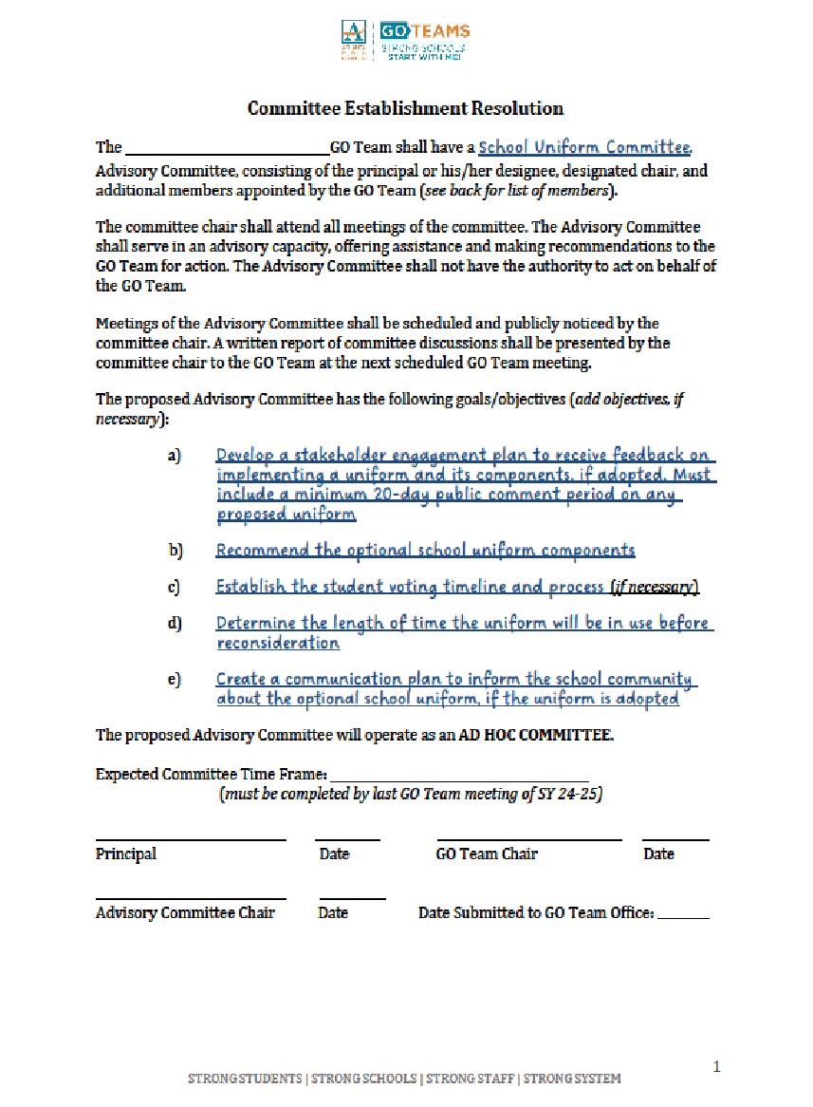
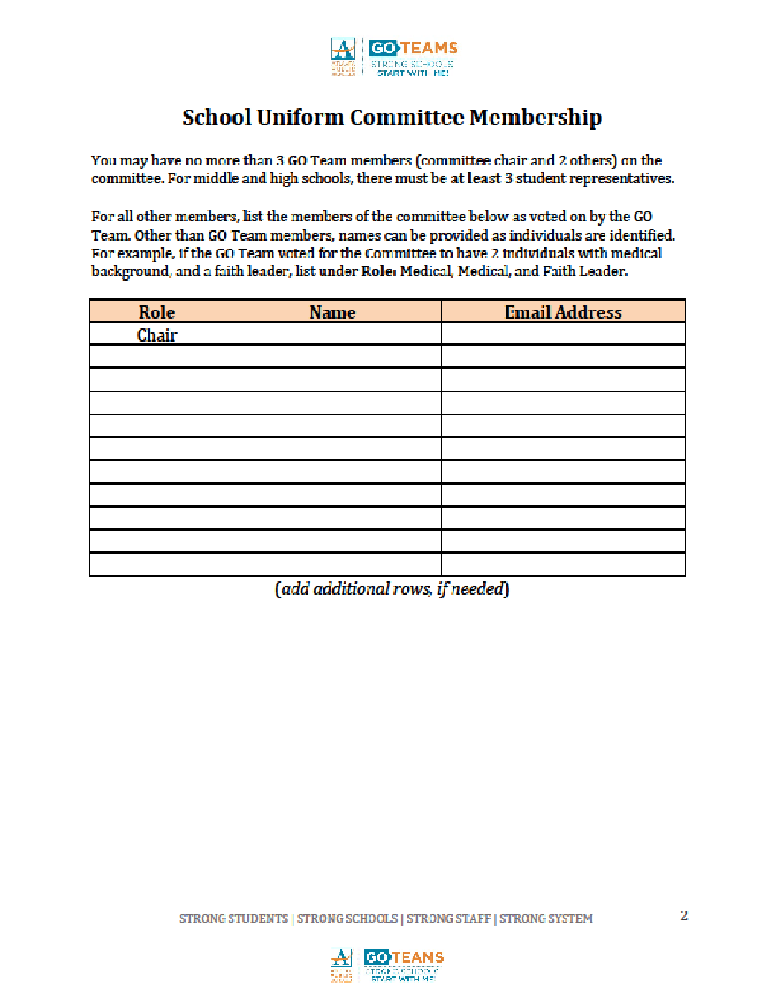
BLANK COMMITTEE RESOLUTION

Slide 13
PRINCIPAL’S REPORT

Slide 14
Toomer
LEVELING AND FY25 BUDGET ADJUSTMENT
Date

Slide 15
ENROLLMENT
Projected Enrollment | 439
15-Day Count(08.21.24) Enrollment | 453
Difference | 14
LEVELING
Leveling is the process the District uses to adjust school budget allocations to match student enrollment.
Budget Adjustment* | $312,059
*The budget adjustment reflects the impact of the following: enrollment changes, FY25 reserve, adjustments to Title I, Family Engagement and School Improvement Allocations, Security Grants and FY24 carryover funds
Notes:
Principals: Based on your15-Day count, please give your GO Team an overview of your projected vs. 8/21 enrolled numbers as well as information on your FY25 budget adjustment.

Slide 16
Plan for FY25 Leveling Reserve
$__(93,674)___
Priorities | APS FIVE Focus Area | Strategies | Requests | Amount
Priorities | APS FIVE Focus Area | Strategies | Requests | Amount
Intentionally focus on closing the subgroups achievement gaps | Fostering Academic Excellence for All | Increase Media choices Digital Textbooks | Media textbooks Lexia | $10,000 12,000
Create a system of supporting problem solving and action with students and staff through the lens of IB. | Fostering Academic Excellence for All | Professional Development for staff for production studio | PD/consultant | $10,000
Implement research-based teaching strategies supported by student data. | Fostering Academic Excellence for All | Professional Development for staff Professional Development Text Provide teachers with appropriate materials for research-based instruction | IRA Conference PD Text Supplies/Class text | $15,000 $5,000 $30,000
Notes:
Review the previously discussed plan for the FY25 Leveling Reserve as discussed by the GO Team in your Feb. 2024 Budget Feedback meeting and March 2024 Approval meeting.

Slide 17
Plan for FY25 Title I Holdback
$___4,864___
Priorities | APS FIVE Focus Area | Strategies | Requests | Amount
Priorities | APS FIVE Focus Area | Strategies | Requests | Amount
Create and implement a system that promotes equitable practices in all areas of the school community. | Fostering Academic Excellence for All | Monthly Engagement activities with the lens of IB and academics | Supplies and materials for monthly engagement | 14,960
Notes:
Review the previously discussed plan for the FY25 Title I Holdback as discussed by the GO Team in your Feb. 2024 Budget Feedback meeting and March 2024 Approval meeting.

Slide 18
SUMMARY OF CHANGES AS A RESULT OF FY25 BUDGET ADJUSTMENT
Personnel Changes | Non-Personnel Changes
1 DSE Teacher | Funds for professional development for IB, Mathematics, literacy
 | Additional teacher tutors during the school hours for targeted small group instruction
 | After School Club salaries and materials
Summary of Changes
PRINCIPALS: Please provide a summary of the impact these changes and how it relates to your strategic plan here.

Slide 19
JOIN US ON SATURDAY, SEPTEMBER 28 All GO team members are invited, but plan to have at least 3 members of your GO Team attend!

Slide 20
QUESTIONS?

